Slide 1
Mid semester presentation
Supervisor: Jeremy Levy
Students: Tom Azoulay and Hadassa Malka
Lab: VISL

Slide 2
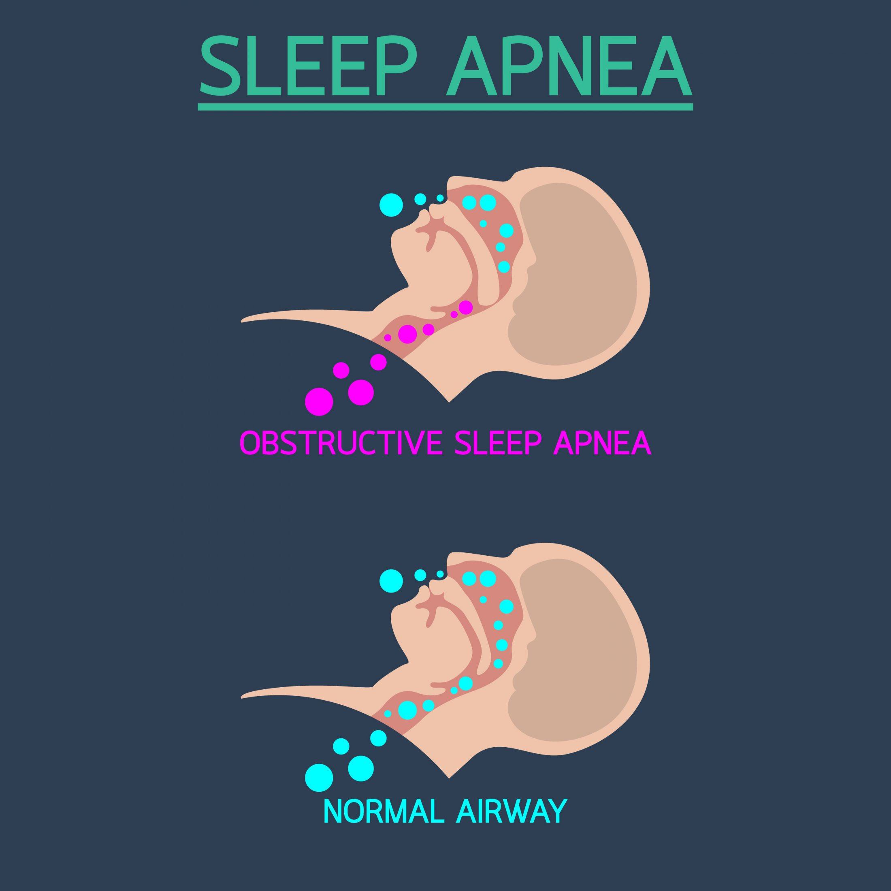

Objective
Diagnostic and classification of OSA pathology in patients applying machine learning techniques on $SPO_{2}$ signals .

Slide 3
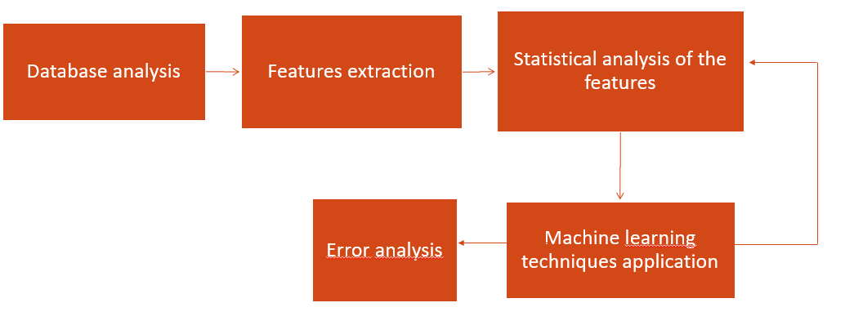
Pipeline of the project

Slide 4
Pipeline of the project
Database analysis
Features extraction
Statistical analysis of the features
Machine learning techniques application
Error analysis

Slide 5
Pipeline of the project
Database analysis
Features extraction
Statistical analysis of the features
Machine learning techniques application
Error analysis

Slide 6

Database analysis
Dataset of 5793 oximetry signal records (about eight hours each).
The patients are divided in four categories:
- No OSA: $AHI<5$
- Mild OSA: $5≤AHI<15$
- Moderate OSA: $15≤AHI<30$
- Severe OSA: $AHI≥30$

Slide 7
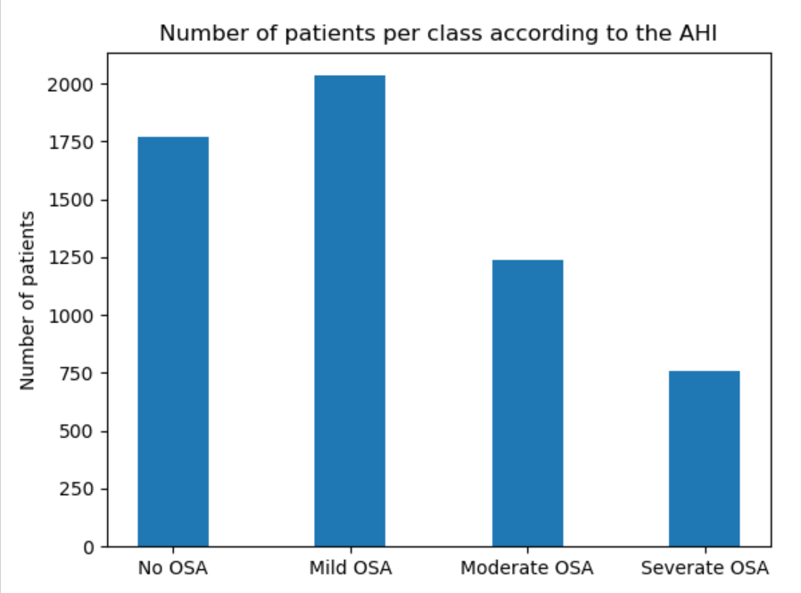
Database analysis
Distribution of the patients:

Slide 8

Features extraction
Five classes of features:
- General statistics: $SPO_{2}$ time series distribution (mean, max,…).
- Complexity: long range correlations in non-stationary time series.
- Periodicity: consecutive pseudoperiodic events in the $SPO_{2}$ time series.
- Desaturations: statistics of the desaturation patterns in the time series.
- Hypoxic burden: Degree of hypoxemia imposed to some organs.

Slide 9
Features extraction
Pre-processing the signals:
- Set_range method: remove non physiological values.
- Median_SPO2 method: median filter of 9 seconds to smooth the signals in order to avoid irregular increase/decrease of oxygen saturation.

Slide 10
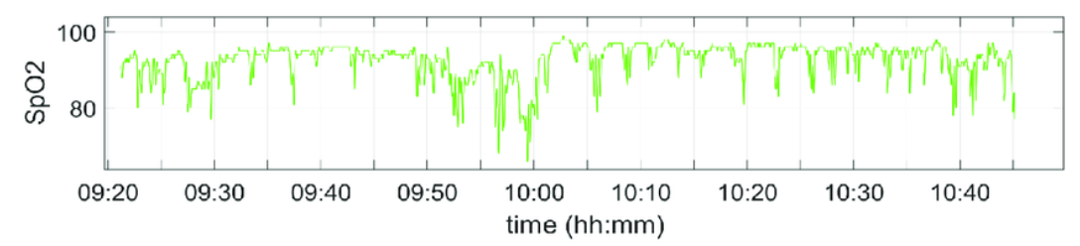
Features extraction
Splitting the signals in windows of about two hours each.
For each window, 44 features have been extracted.

Slide 11
Features extraction

Slide 12

Statistical analysis
Finding discriminability of the features with Kruskal-Wallis algorithm.
Removing features with a $p_{value}>0.05:$LZ, Min, DS_sd, DA100_sd.

Slide 13
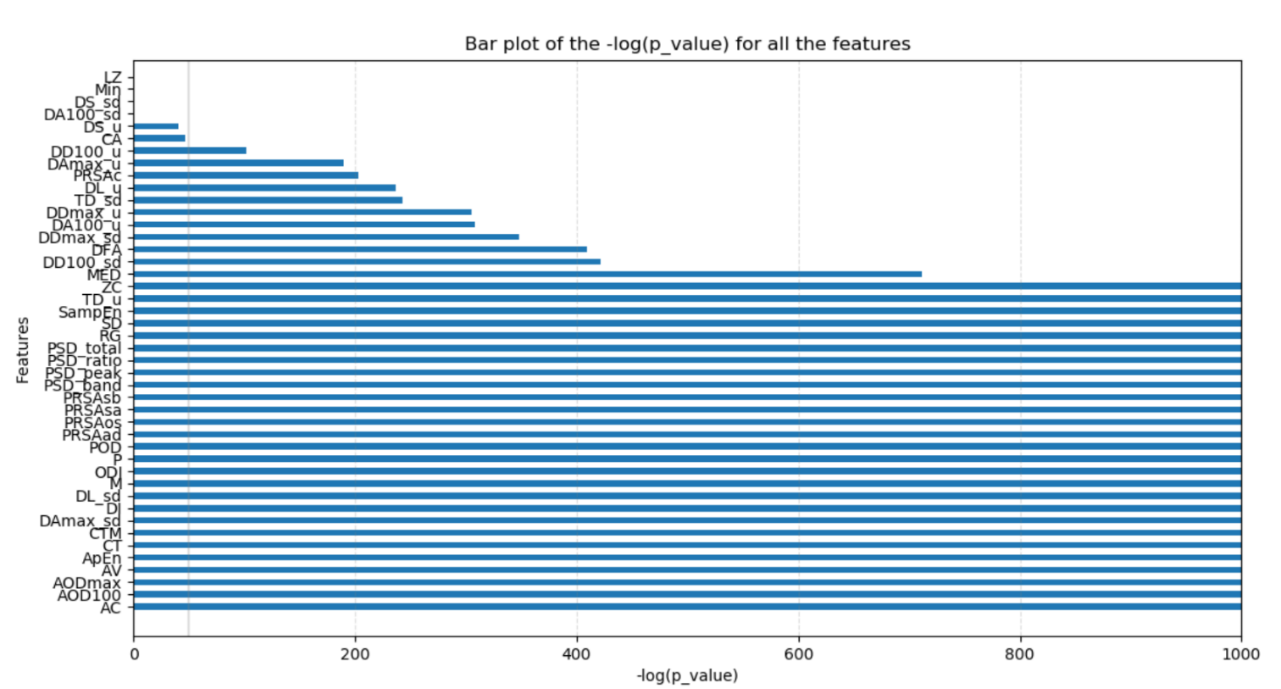
Statistical analysis
Bar plot of -log(p_value) for the 44 features:

Slide 14
Machine learning application

Slide 15
Machine learning application
Applying five Machine Learning classifiers:
- Logistic Regression
- Adaboost
- Random Forest
- KNN
- SVM
Using K-fold cross validation to asset the best parameters.

Slide 16
Machine learning application
K-fold cross validation (K=3)
Fold 1
Fold 2
Fold 3
Fold 1
Fold 2
Fold 3
Fold 1
Fold 2
Fold 3
Train
Validation

Slide 17
Machine learning application

Slide 18
Machine learning application

Slide 19
Machine learning application

Slide 20
Future objectives
Feature selection (mRMR,…) and predictions in adequation.
Classification of patients using its whole signal (combining the predictions for each window).
Error analysis

Slide 21
SUPPLEMENTS

Slide 22
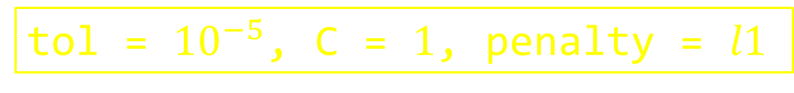
Machine learning application
Logistic Regression
Tuned parameters:
- C: Inverse of regularization term
- penalty: Penalty option for regularization
- tol: Threshold for convergence tolerance
Best parameters tuned:
tol = ${10}^{−5}$, C = $1$, penalty = $l1$

Slide 23
Machine learning application
Result of Logistic regression on test set:
Overall scores:
Result on the different classes:
F1 score | Accuracy | ROC AUC
0.5115 | 0.5143 | 0.7957
F1 score | Accuracy | Specificity | Precision | Sensitivity | ROC AUC

Slide 24
Machine learning application
K-NN
Tuned parameters:
- n_neighbors: number of closest neighbors to find.
- p: type of distance for Minkowski metric
- weights: weights function for prediction
Best parameters tuned:
n_neighbors = $30$, P = $1$, weights = $distance$

Slide 25
Machine learning application
Result of Logistic regression on test set:
Overall scores:
Result on the different classes:
F1 score | Accuracy | ROC AUC
0.5115 | 0.5143 | 0.7957
F1 score | Accuracy | Specificity | Precision | Sensitivity | ROC AUC

Slide 26
Machine learning application
Adaboost
Tuned parameters:
- n_estimators: maximum number of estimators to finish boosting.
- learning_rate: shrinks contribution of each classifier
Best parameters tuned:
n_estimators = $100$, learning_rate = $0.1$

Slide 27
Machine learning application
Result of Logistic regression on test set:
Overall scores:
Result on the different classes:
F1 score | Accuracy | ROC AUC
0.5115 | 0.5143 | 0.7957
F1 score | Accuracy | Specificity | Precision | Sensitivity | ROC AUC

Slide 28
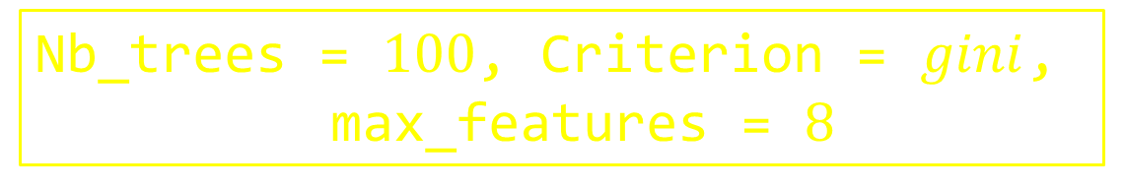
Machine learning application
Random Forest
Tuned parameters:
- Nb_trees: number of closest neighbors to find.
- Criterion: type of distance for Minkowski metric
- Max_features: weights function for prediction
Best parameters tuned:
Nb_trees = $100$, Criterion = $gini$,
max_features = $8$

Slide 29
Machine learning application
Result of Logistic regression on test set:
Overall scores:
Result on the different classes:
F1 score | Accuracy | ROC AUC
0.5115 | 0.5143 | 0.7957
F1 score | Accuracy | Specificity | Precision | Sensitivity | ROC AUC

Slide 30
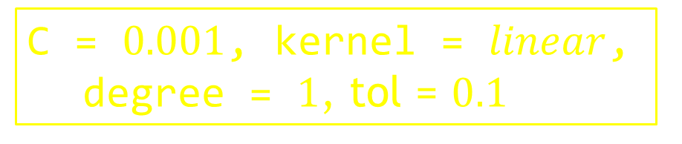
Machine learning application
SVM
Tuned parameters:
- C: inverse of regularization term.
- kernel: kernel type for algorithm.
- degree: degree of polynomial kernel function
- Tol: tolerance for stopping criterion
Best parameters tuned:
C = $0.001$, kernel = $linear$, degree = $1$, tol = $0.1$

Slide 31
Machine learning application
Result of Logistic regression on test set:
Overall scores:
Result on the different classes:
F1 score | Accuracy | ROC AUC
0.5115 | 0.5143 | 0.7957
F1 score | Accuracy | Specificity | Precision | Sensitivity | ROC AUC

